Slide 1
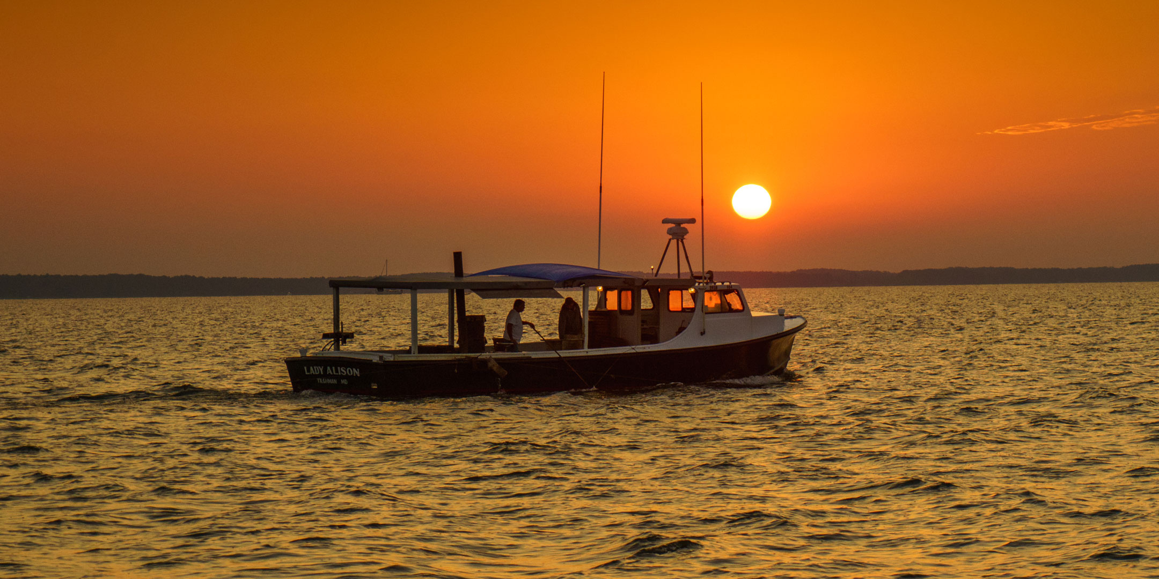
Talbot County, Maryland
Department of Economic Development and Tourism
May 2025

Slide 2
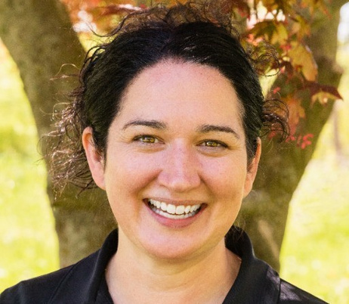
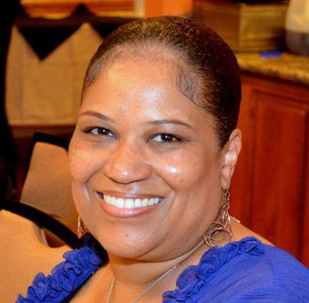
OUR TEAM
Kristen Goller
Candace Harris
Tourism Manager, Wife & Mom, Daughter, Superhero
Admin. Assistant, Daughter, Mom-Mom, Tiger Tamer

Slide 3
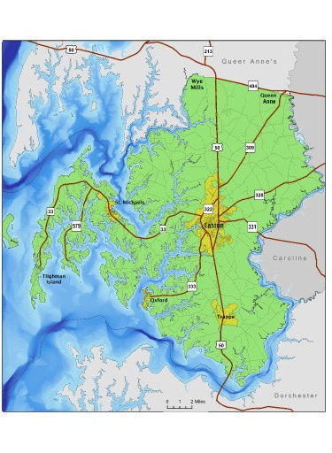
Destination Marketing Organization
The Department of Economic Development and Tourism is the official DMO for Talbot County, designated by the State of Maryland.

Slide 4
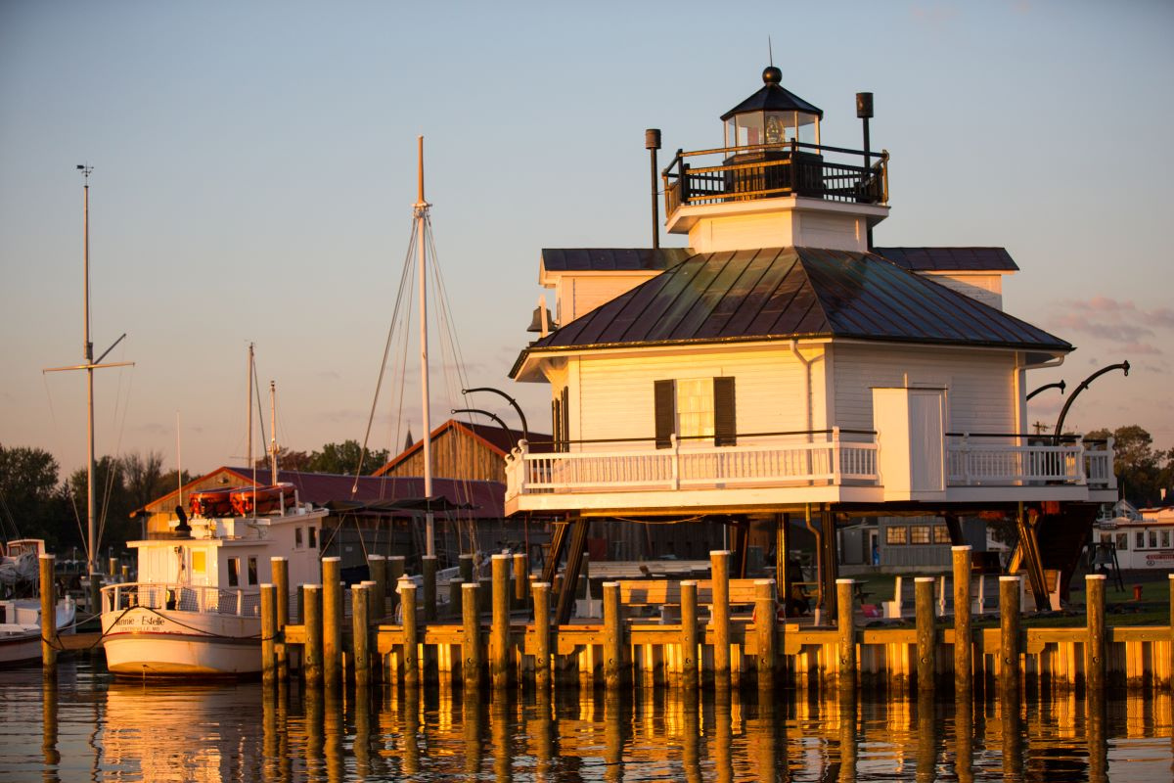
What is Destination Marketing?
  A specialized form of marketing that promotes a specific location to attract visitors and boost the local economy.
  Goes beyond conventional marketing efforts, aiming to create a compelling narrative that captivates potential travelers.
  Focus is on crafting an identity for a destination, transforming it from a spot on the map to a must-visit experience.

Slide 5
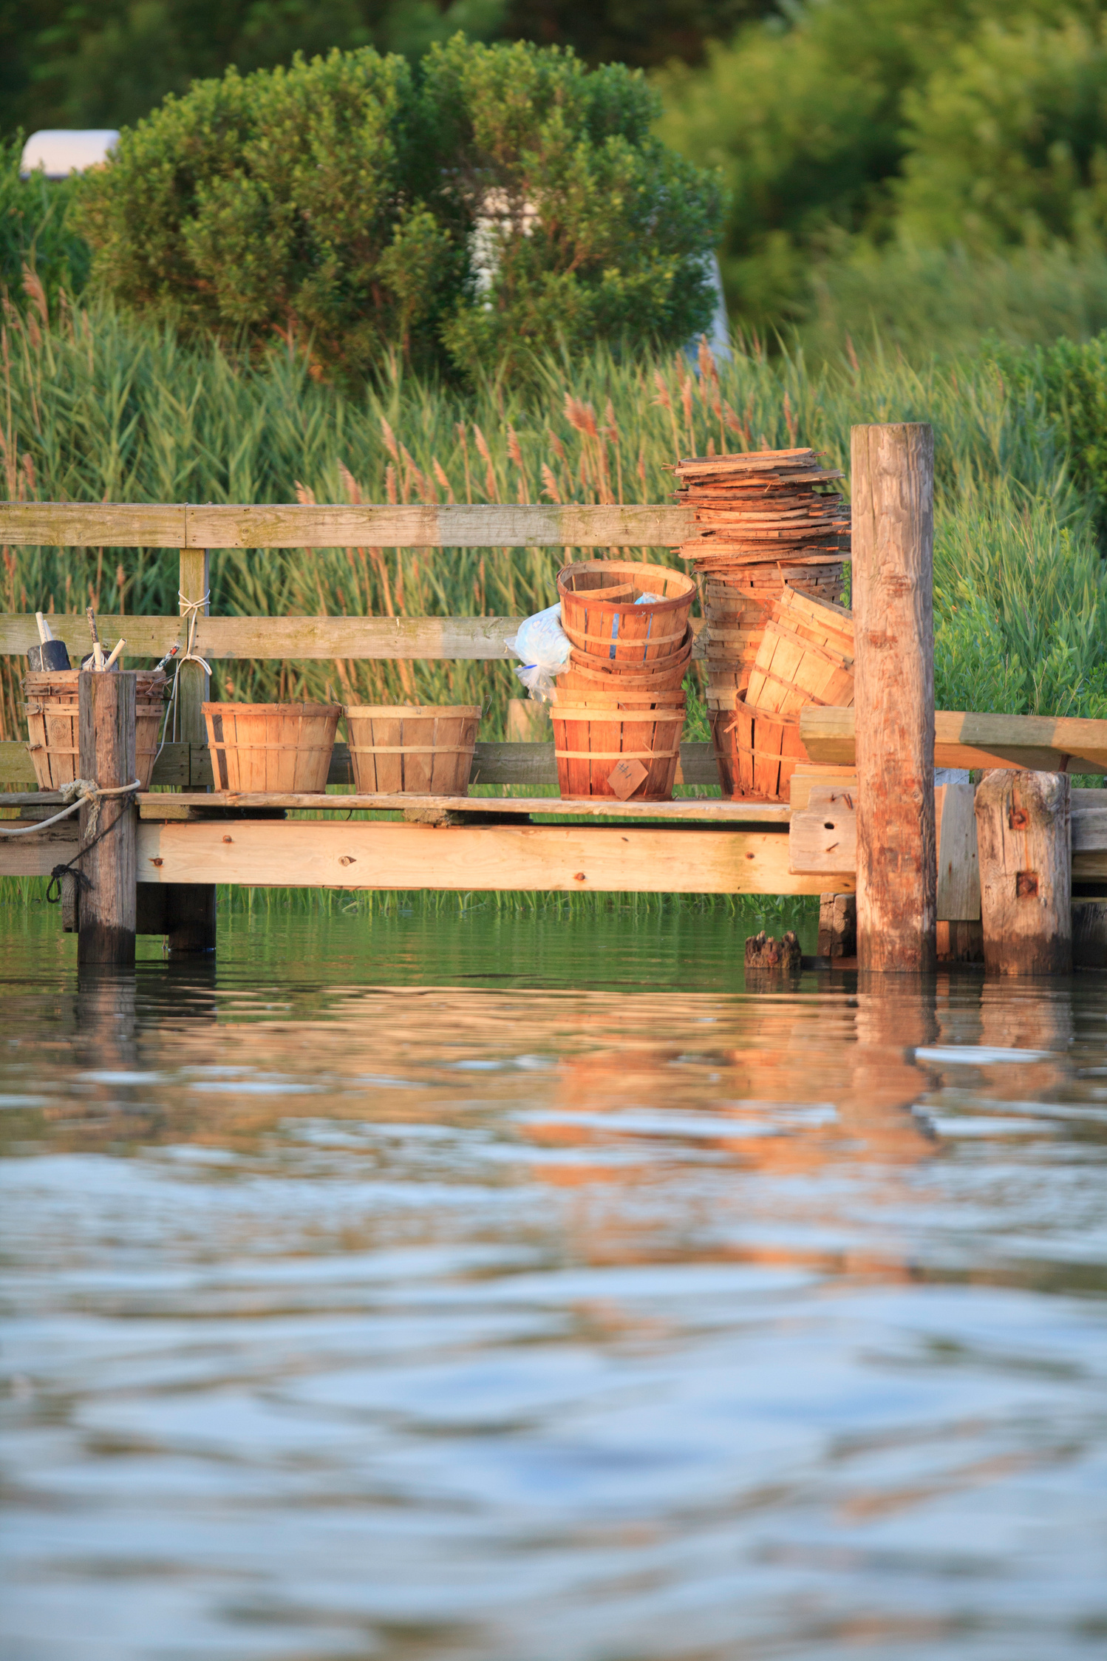
There’s a transformation underway.
Destination marketing is no longer just about promoting attractions — it’s about reimagining how destinations engage with travelers and contribute to their communities. Leading destination marketing organizations (DMOs) are embracing bold strategies to balance visitor satisfaction, economic growth, and local well-being. ~ Sojern State of Destination Marketing 2025

Slide 6
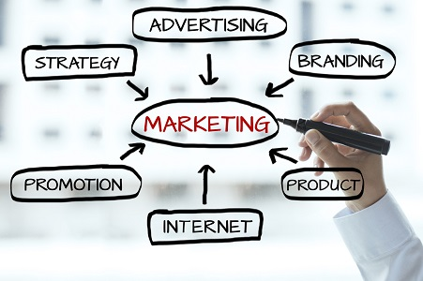

Slide 7



Marketing and Communications
Positioning Talbot County as a premier travel destination
Owned Media
Paid Media
Earned Media
Channels that we control, online and off. Includes website, social, media, print publications.
Media opportunities that we purchase. This is any medium where you pay to play.
Talbot County hosts journalists from around the country and around the world.

Slide 8



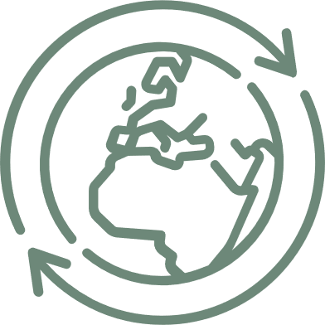
Owned Media
TourTalbot.org
Social Media
Most important asset; the digital gateway for anyone interested in things to see and do
Facebook, Instragram, LinkedIn
Drive people to TourTalbot.org
Travel Guide
Publications
Last printed mid-2024; magazine format with evergreen content
Bike Maps, Water Trails Maps, Restaurant Guide, FD Driving Tour

Slide 9

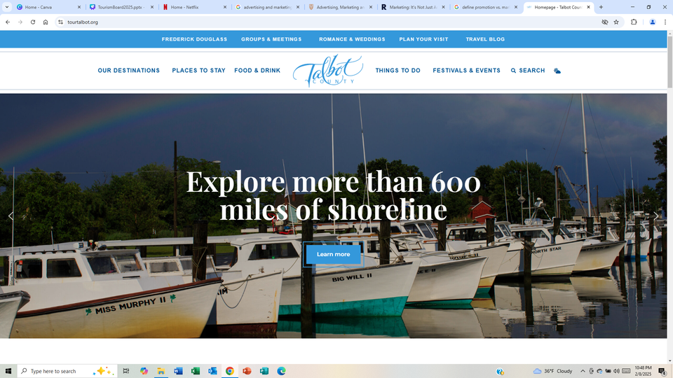
TourTalbot.org
  Primary online gateway for potential visitors to discover information, forming their initial impression and influencing their decision to travel to Talbot County.
  Travelers visit 277 different websites before booking a trip, up more than seven-fold over 2013, when travelers visited 38 websites before booking, says Expedia.
  Expedia’s Path to Purchase Study shows 32% of U.S. travelers use destination websites to plan a trip.

Slide 10

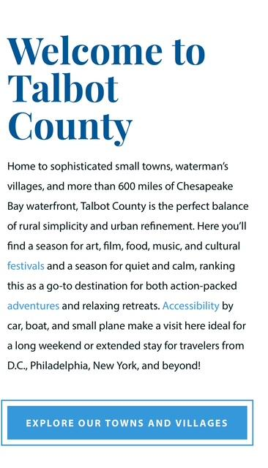
It’s a mobile world.
A PYMNTS study released in April 2025 shows that more than 7 in 10 U.S. consumers prefer using mobile devices when booking local travel. Nearly 6 in 10 say the same for long-distance travel and rental cars.
Travelers use social media for inspiration, to see others experiences and share their own, and sometimes to book travel.

Slide 11
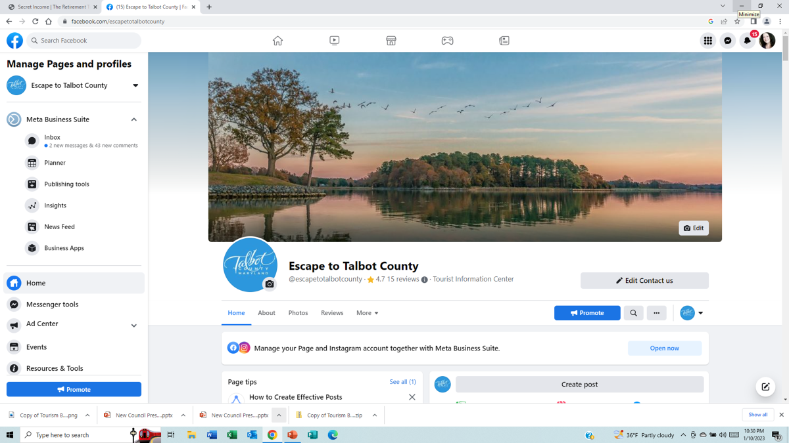

Slide 12
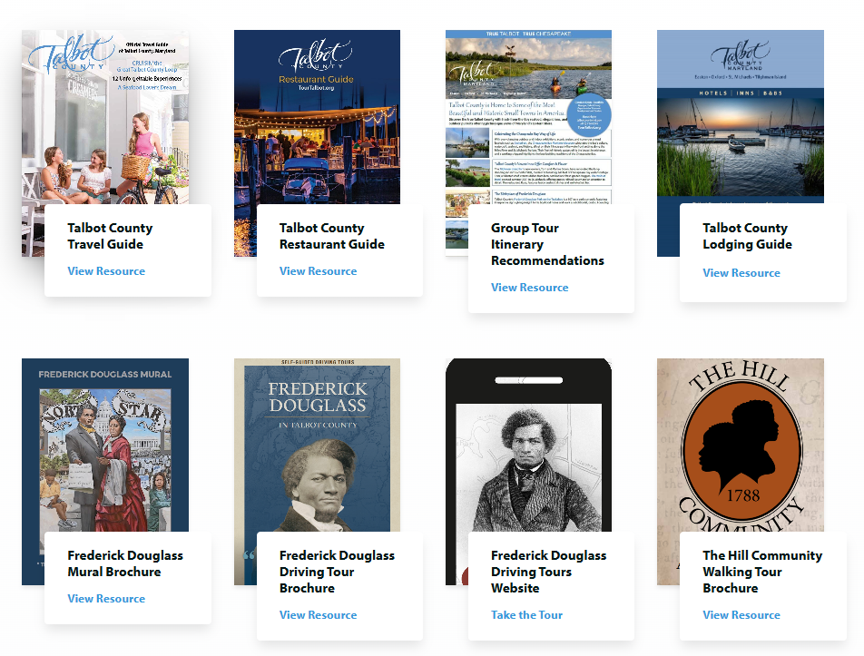

Slide 13
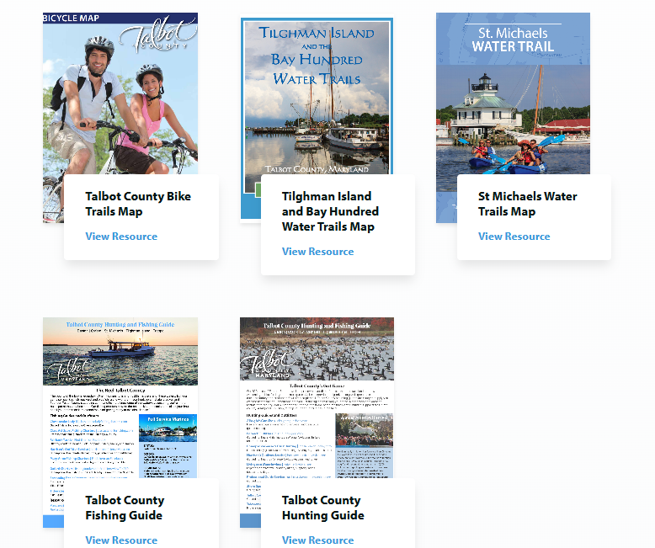

Slide 14
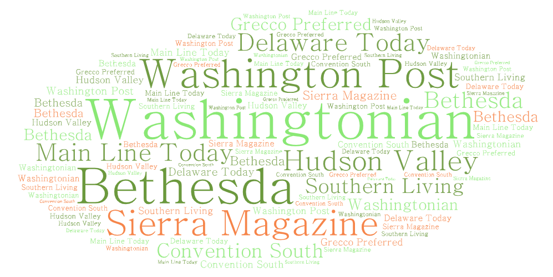
Earned Media

Slide 15
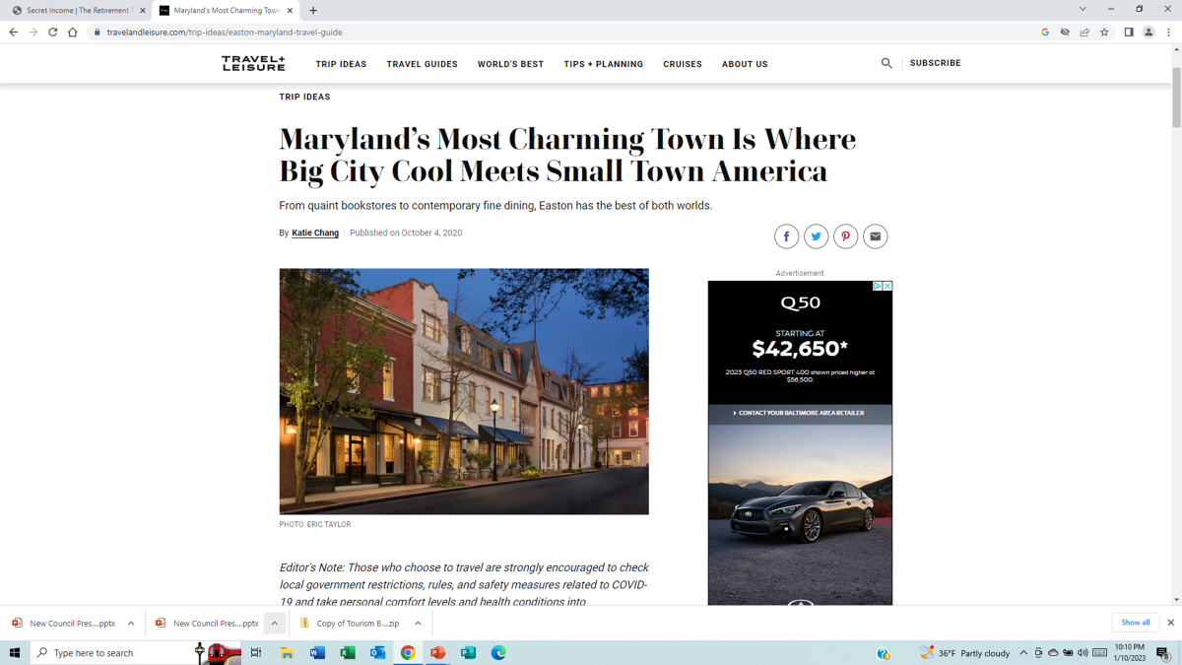
Earned Media

Slide 16

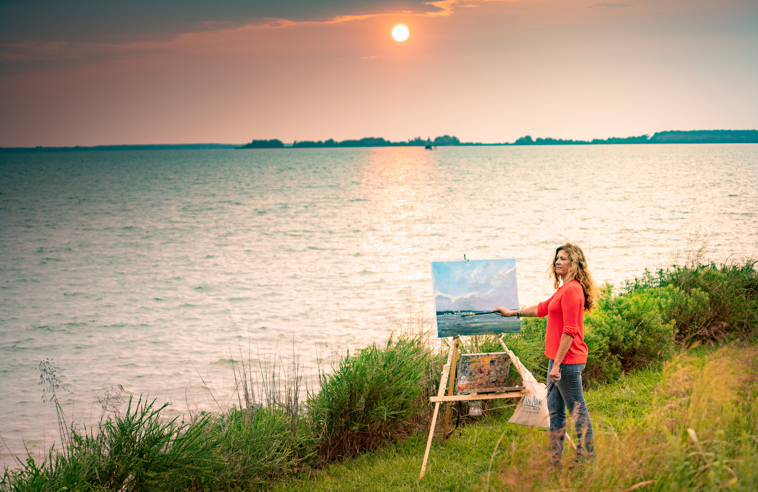
Paid Media
Quite simply, this is advertising that you purchase.

Slide 18
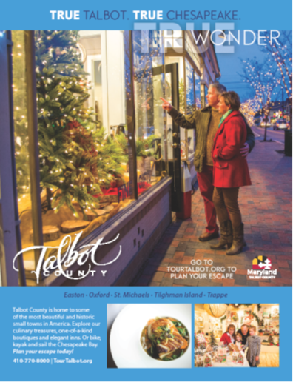
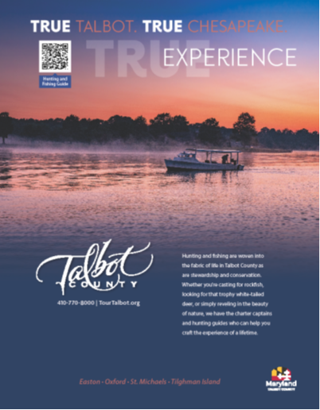

Slide 19
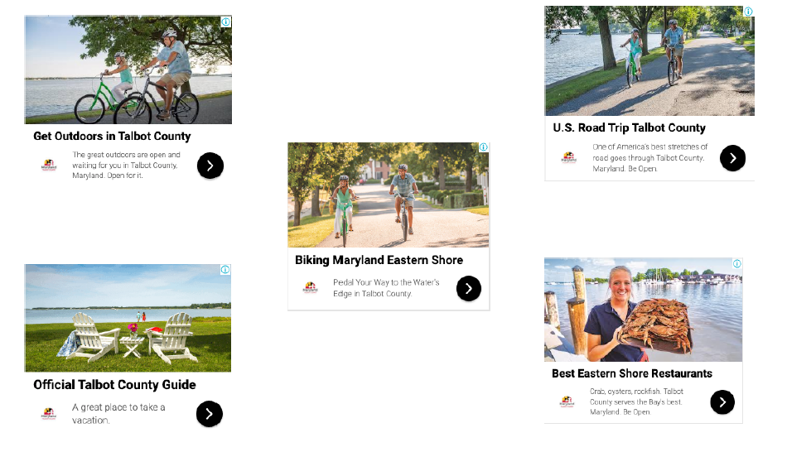

Slide 20
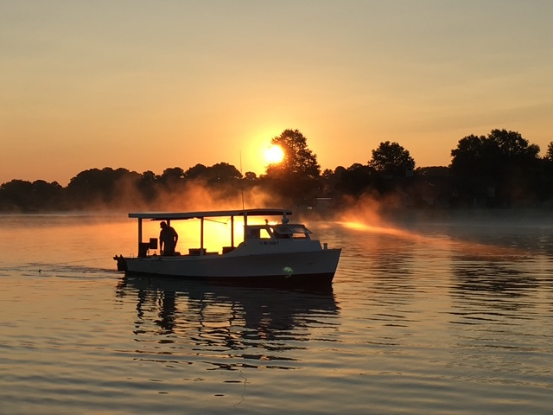
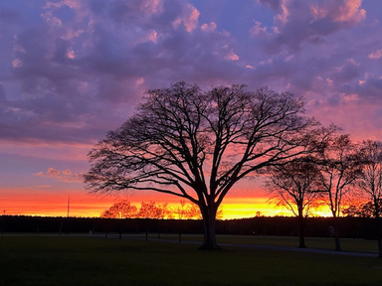
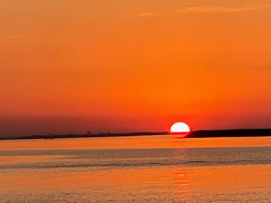
Cassandra’s Rules for Destination Advertising
01
Digital First.
If you only have one dollar, spend it where they are when they are looking for you.
02
Always On.
Create an advertising strategy that works 24 hours a day, seven days a week.
03
Spend closest to the dollar.
Invest most of the county’s resources where travelers are making decisions that result in tourism revenue.

Slide 21
MEASURE EVERYTHING
1.32 million
3:36
Website users reached since 2017.
Average session duration, measured in minutes.
2.3+
284,000
11,600+
Average pages per session for website visitors.
Outbound clicks from TourTalbot.org to partners.
Travel Guide downloads from website.
Statistics provided by MediaOne North America.

Slide 22
Convergence
Paid + Owned + Earned = Converged Media
Experimenting with new types of paid media.
Paid Media
Capitalizing on partner networks such as CRUSA, MATPRA, and OTD.
Always seeking to be where they are when they are looking for us.
Owned Media
Earned Media

Slide 23
2025
A Look Ahead

Slide 24
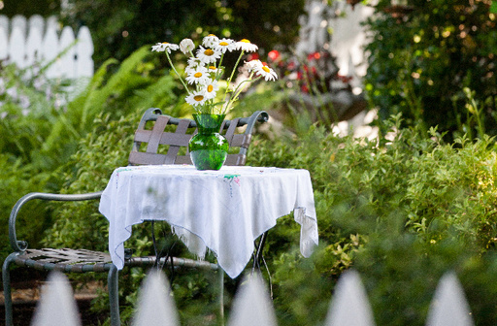
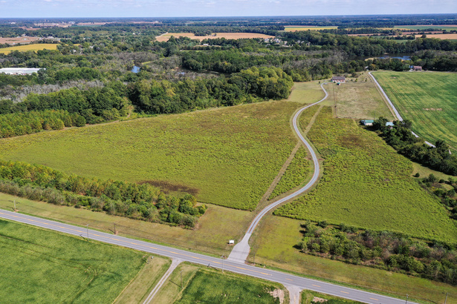
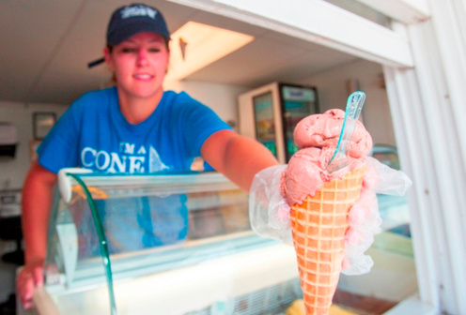
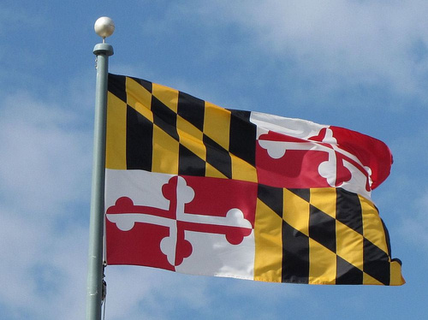
2025-2026 Priorities
Website
FD Park
Redesign in 2025; seeking a leader in destination marketing.
Continue to pursue state or national designation for park near birthplace.
Travel Guide
Welcome Ctr.
Last published in 2024; needs to be ready for 2026 travel season.
Finalize plans for new facility adjacent to UMSRH RMC.

Slide 25
Additional Projects and Events
Talbot 250 Commission
Organized to promote the 250th anniversary of the United States and Talbot County’s role in its founding.
Bike and Pedestrian Advisory Committee
Council-appointed committee tasked with developing a county-wide master plan and weighing in on future trail development and safety issues.
Maryland Main Street Conference
More than 400 attendees expected for this statewide conference; Talbot County is a supporting partner with Discover Easton.

Slide 26



Implementation of New Technologies
Streamline processes and procedures.
Leverage new technologies to maximize limited staff while also enhancing the user experience with owned media assets.
Adopt best practices.
Ensure messaging is consistent across platforms and that it remains relevant as AI and new SEO algorithms evolve.
Leverage data for decision-making.
Focus on using enhanced data to monitor results and drive decision making for future develops.

Slide 27


2025 Strategic Plan
Economic Development
Tourism
Camoin Associates is crafting a 10-year plan for economic development in Talbot County.
Tourism is one of the largest industry sectors in Talbot County and is an economic driver.

Slide 28

What’s our WHY?

Slide 29
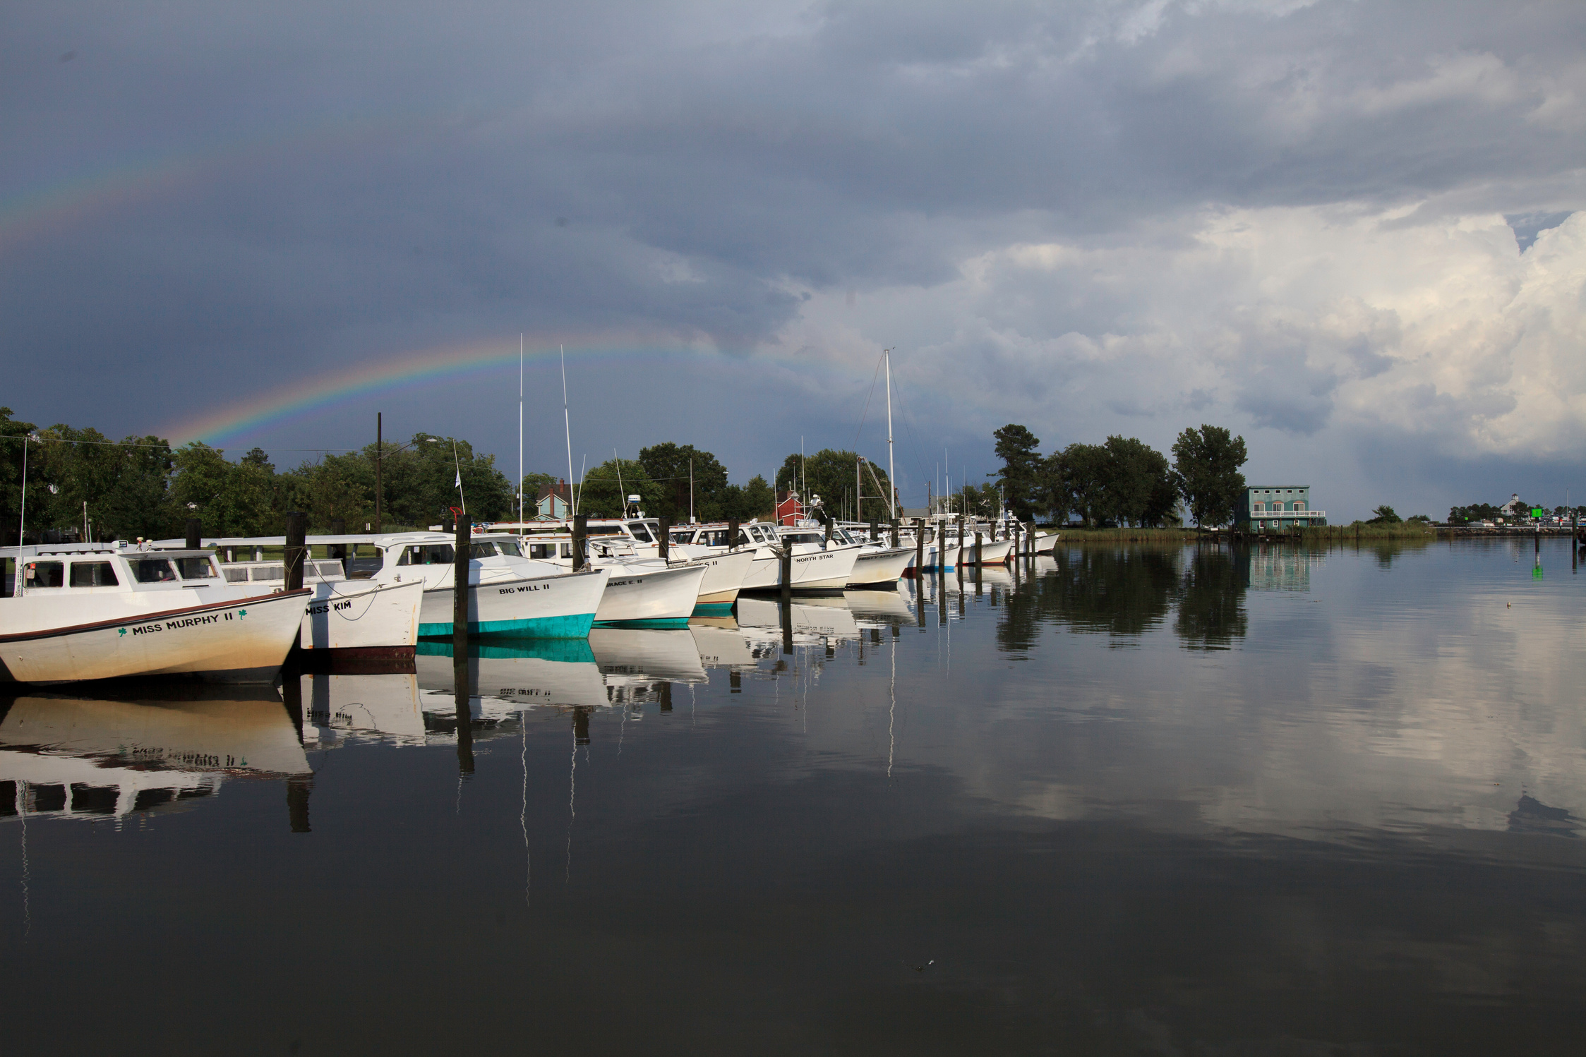
"Traveling – it leaves you speechless, then turns you into a storyteller."
– Ibn Battuta
a.k.a. The Islamic Marco Polo
b. 1304-d. 1368/69

Slide 30
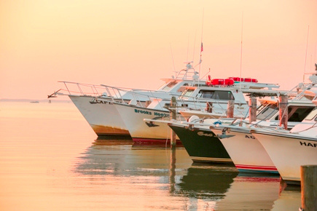
665,000+
Number of Travelers Visiting Talbot County Each Year

Slide 31
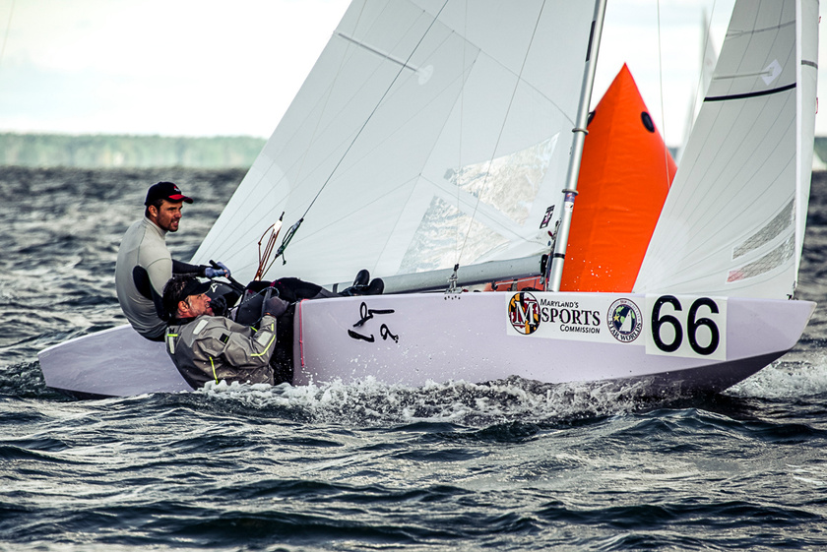
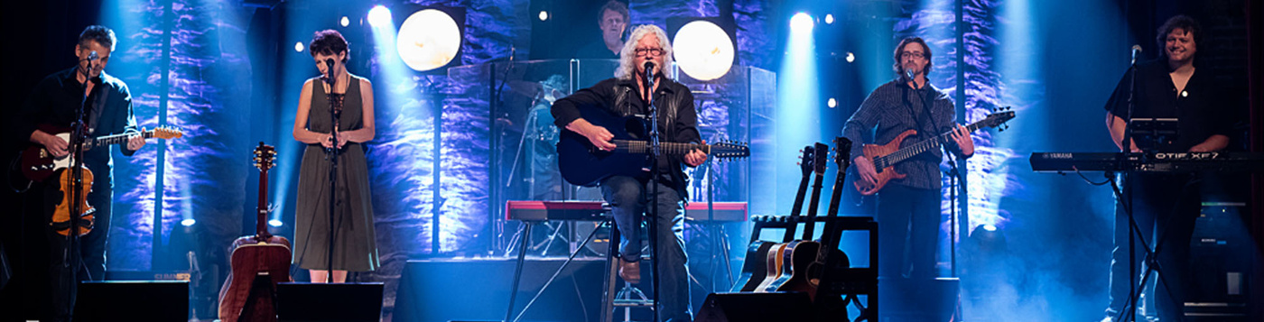
$317.4 million
Visitor Spending in Talbot County
$132 million
Federal, State, and Local Taxes Generated
1,944
Number of Direct Jobs Created

Slide 32
A.I.-Generated List of Differentiators
Waterfront Location
Historic Character
Birthplace of Douglass
More than 600 miles of shoreline on the Bay.
Small towns, plus colonial and maritime history.
FD was born and spent his formative years here.
Culinary Scene
Cultural Depth
Outdoor Recreation
Seafood, particularly blue crabs, oysters, and rockfish
Avalon, Academy, CBMM, galleries, festivals
Water sports, cycling routes, trails, golf courses.

Slide 33
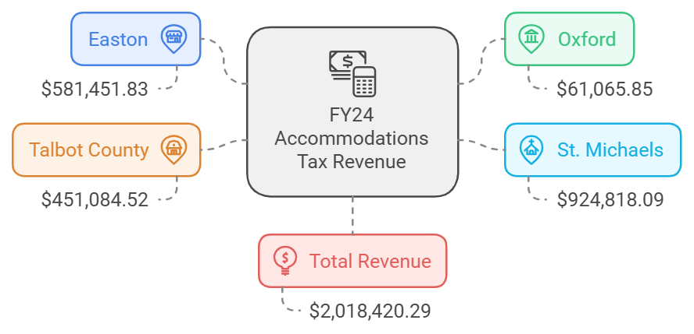

Slide 34
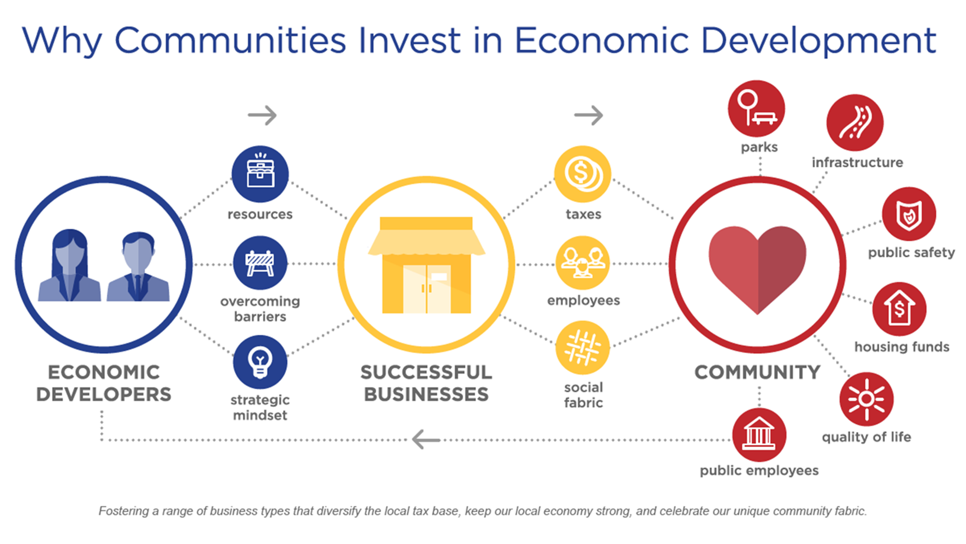

Slide 35
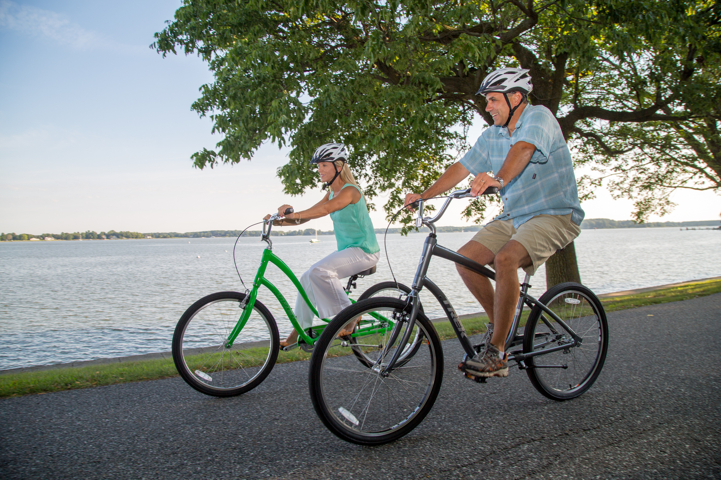
THANK YOU!
Cassandra M. Vanhooser
cvanhooser@talbotcountymd.gov
(410) 770-8000
tourtalbot.org and talbotworks.org
Kristen Goller
kgoller@talbotcountymd.gov
(410) 770-8000
tourtalbot.org and talbotworks.org
CREDITS: This presentation template was created by Slidesgo, and includes icons by Flaticon, and infographics & images by Freepik

