Slide 1


EDC MEETING
June 5, 2025

Slide 2
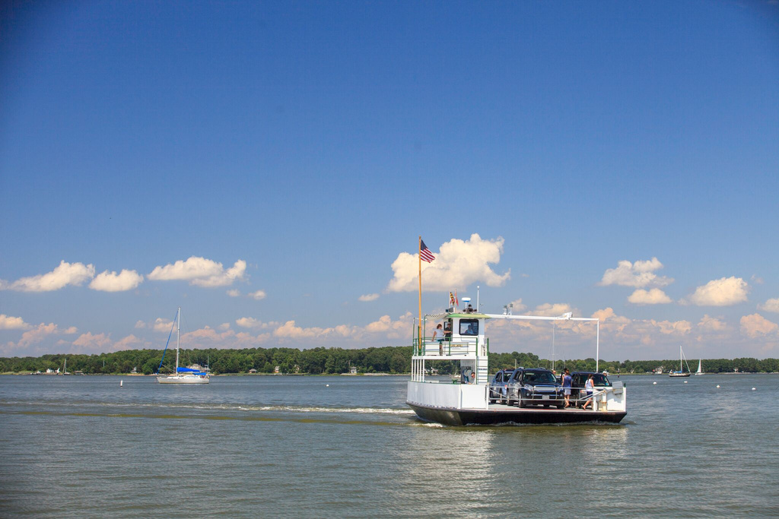
Spring Overview
Events
Programs
The Business Appreciation Summit, our largest community event of the year, was a homerun.
On April 8, 2025, Talbot County graduated its third Business Academy Cohort with 14 small businesses.
Planning
Projects
Our strategic planning process is underway, with an expected delivery date of Autumn 2025.
Funding from federal and state grants has seeded a number of projects that would otherwise stagnate.

Slide 3
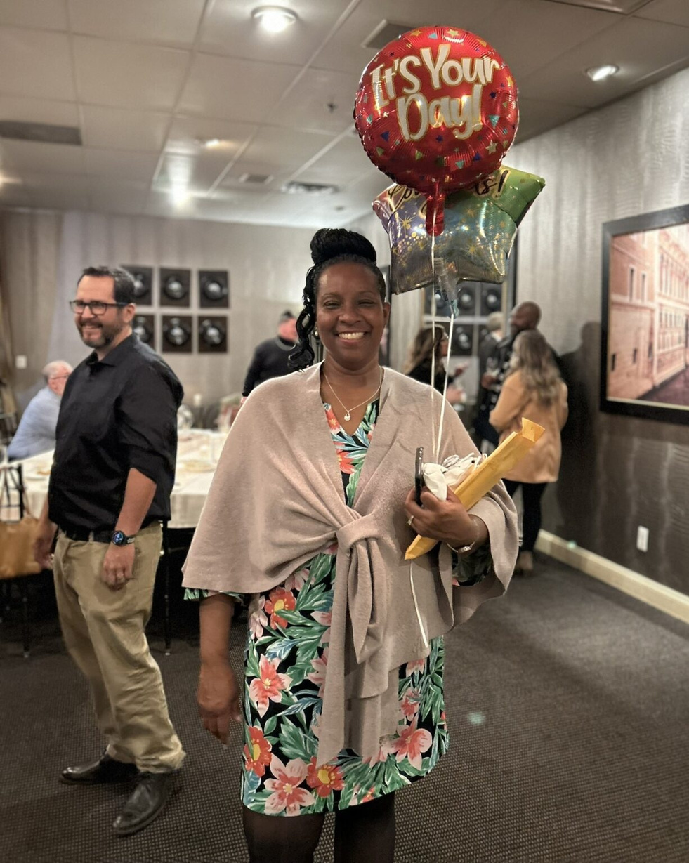
April 8, 2025
Talbot Works Business Academy
The Talbot County Council awarded graduation certificates to 14 participants of the Talbot Works Business Academy in April. The business owners completed an 8-week entrepreneurship course sponsored by the Talbot County Department of Economic Development and Tourism, with each graduate receiving a $2,000 grant to reinvest in their business.

Slide 4
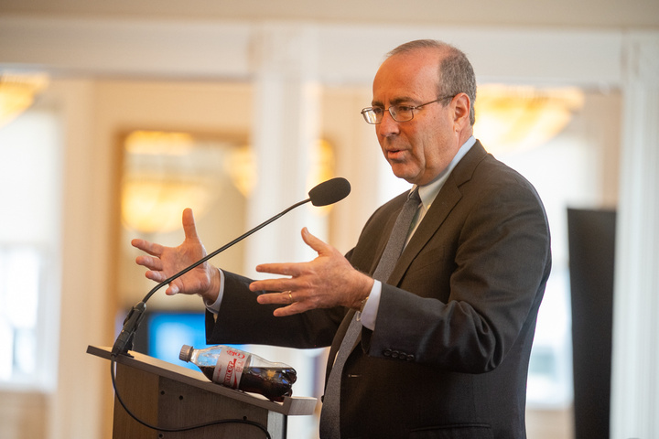
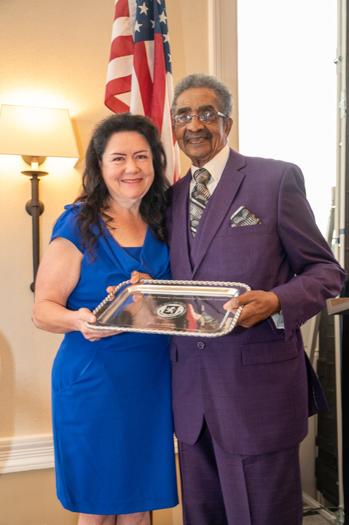
April 10, 2025
Business Appreciation
Featured Tom Barkin, President and CEO, Federal Reserve Bank of Richmond
More than 200 business, government, and community leaders celebrated local achievements and recognized outstanding contributions to economic growth.
Honored SIX Impactful Businesses, Projects, and Individuals

Slide 5
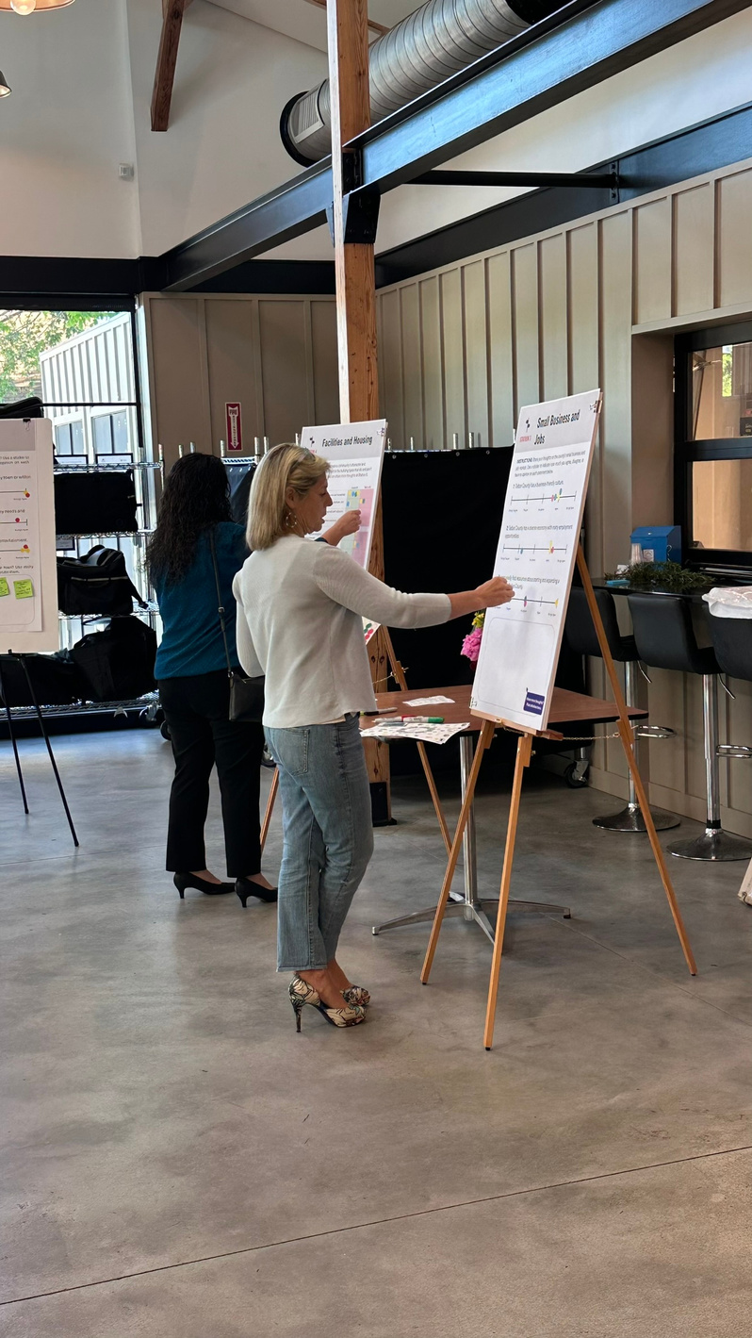
2025 Priority
Strategic Plan
Nationally recognized consulting firm Camoin Associates is leading the process to develop our roadmap for the future.
Open Houses
Focus Groups
Interviews
Six
Five
Electeds
Throughout the County
Coming Up In June
One-on-One Interviews

Slide 6

Public Open Houses, May 6-9

Slide 7
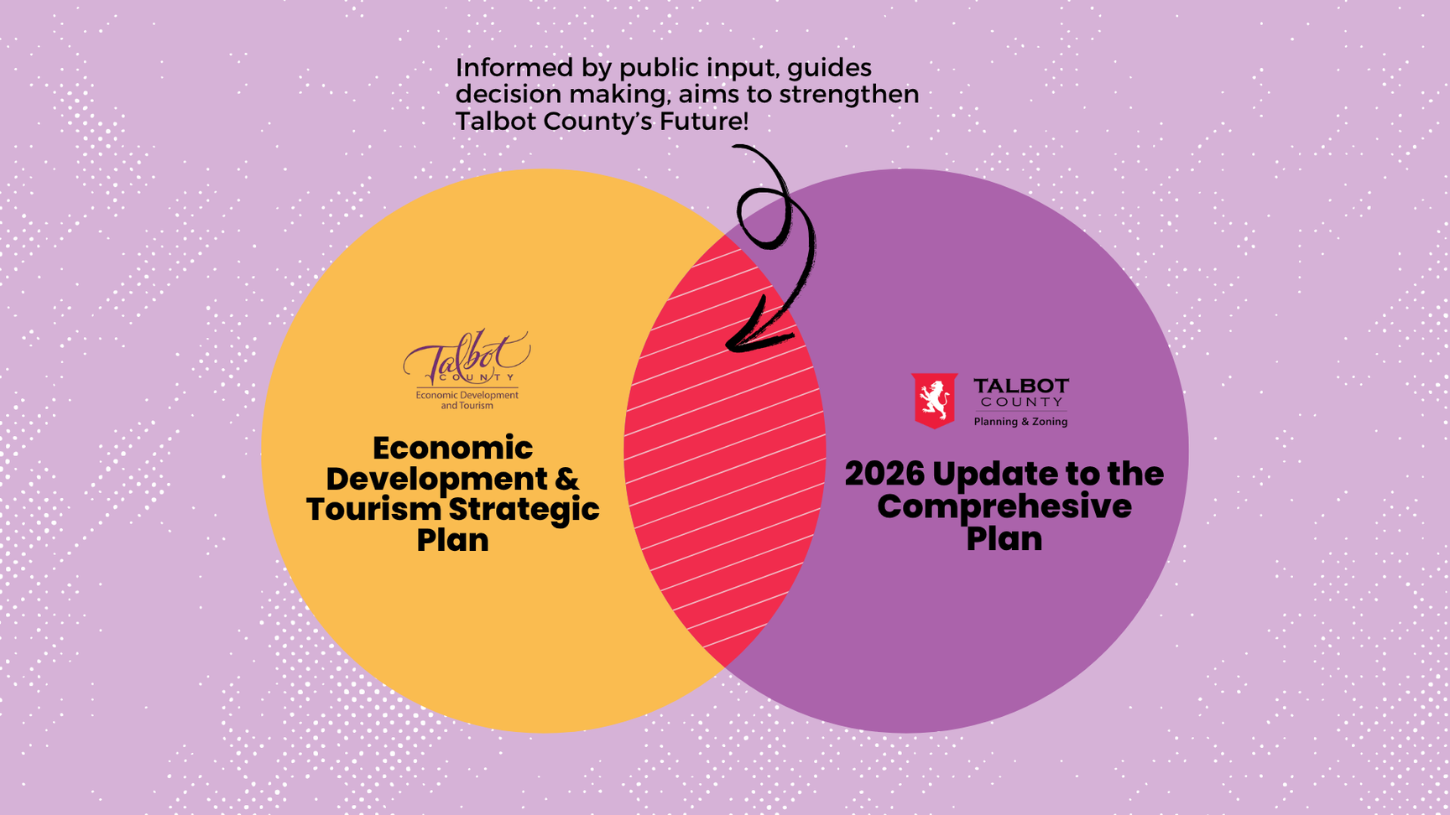

Slide 8
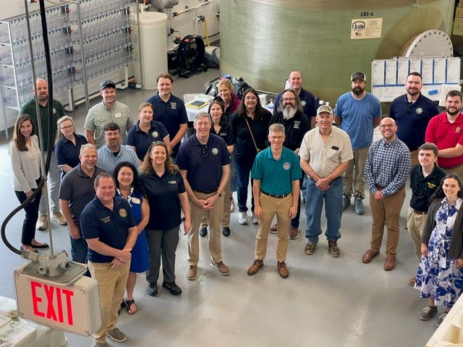

May 15, 2025
Secretary Atticks
Agriculture Meets Aquaculture
Secretary of Agriculture Kevin Atticks and his team visited Talbot County. Special request: aquaculture and seafood marketing.

Slide 9

Priority Projects
Welcome Center Study
June 2025
EDA Grant
October 2025
FD Park on the Tuckahoe
December 2025

Slide 10


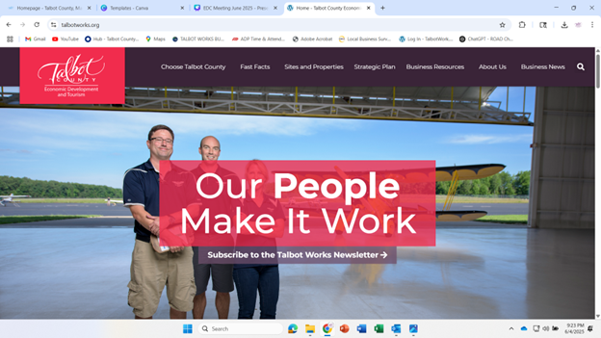

Slide 11

Thank You!

